Slide 1
Software Design
Deriving a solution which satisfies software requirements

Slide 2
Objectives
To introduce the process of software design
To describe the different stages in this design process
To show how object-oriented and functional design strategies are complementary
To discuss some design quality attributes

Slide 3

Programmer’s Approach to
Software Engineering
Skip requirements engineering and design phases;
start writing code

Slide 4
Why this programmer’s approach?
Design is a waste of time
We need to show something to the customer real quick
We are judged by the amount of LOC/month
We expect or know that the schedule is too tight

Slide 5
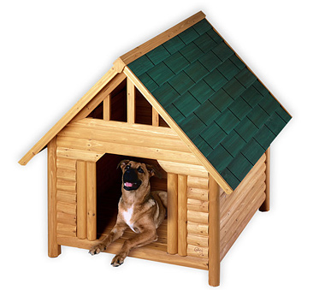

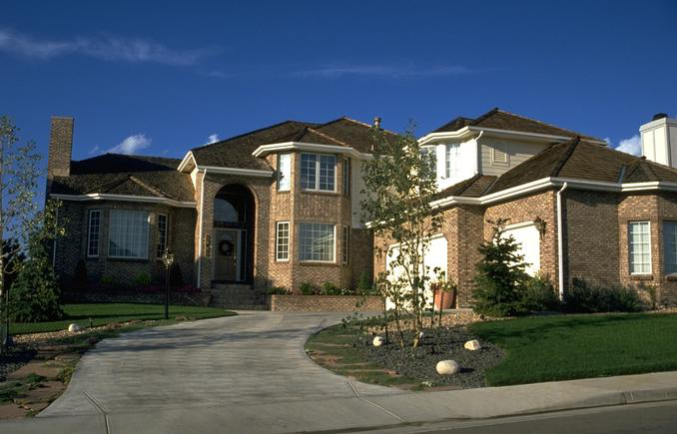
Design of small and large systems
Notes:
Extraida desde la presentación “Software Architecture and UML” de Grady Booch (Rational Software).

Slide 6
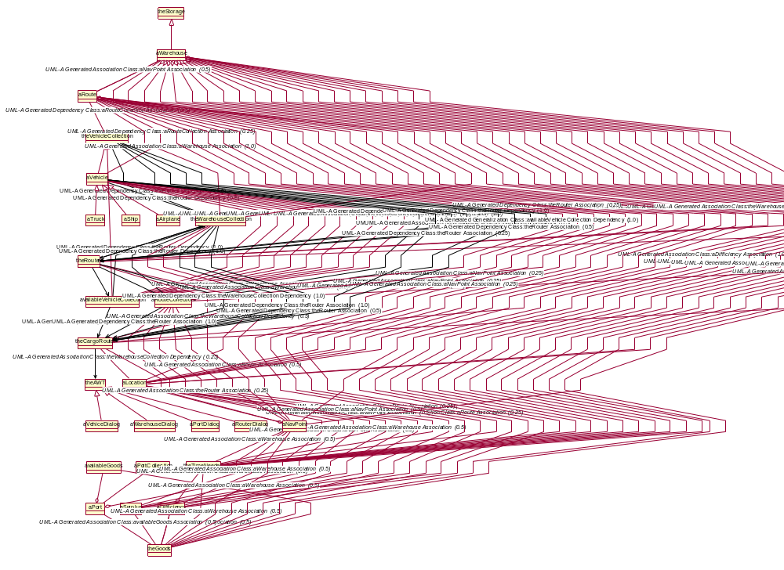
What is the Problem?
This is a simple
software system!

Slide 7
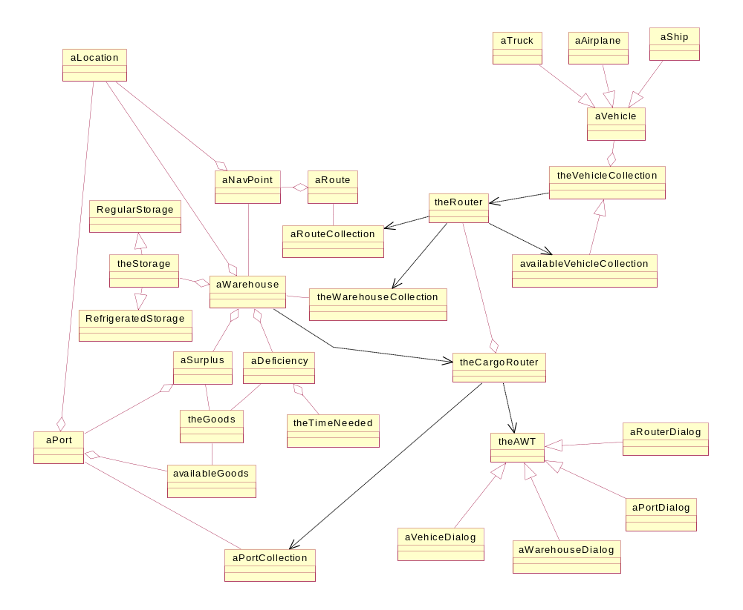
The Usual Tool: Design Abstraction
We have to do better!

Slide 8
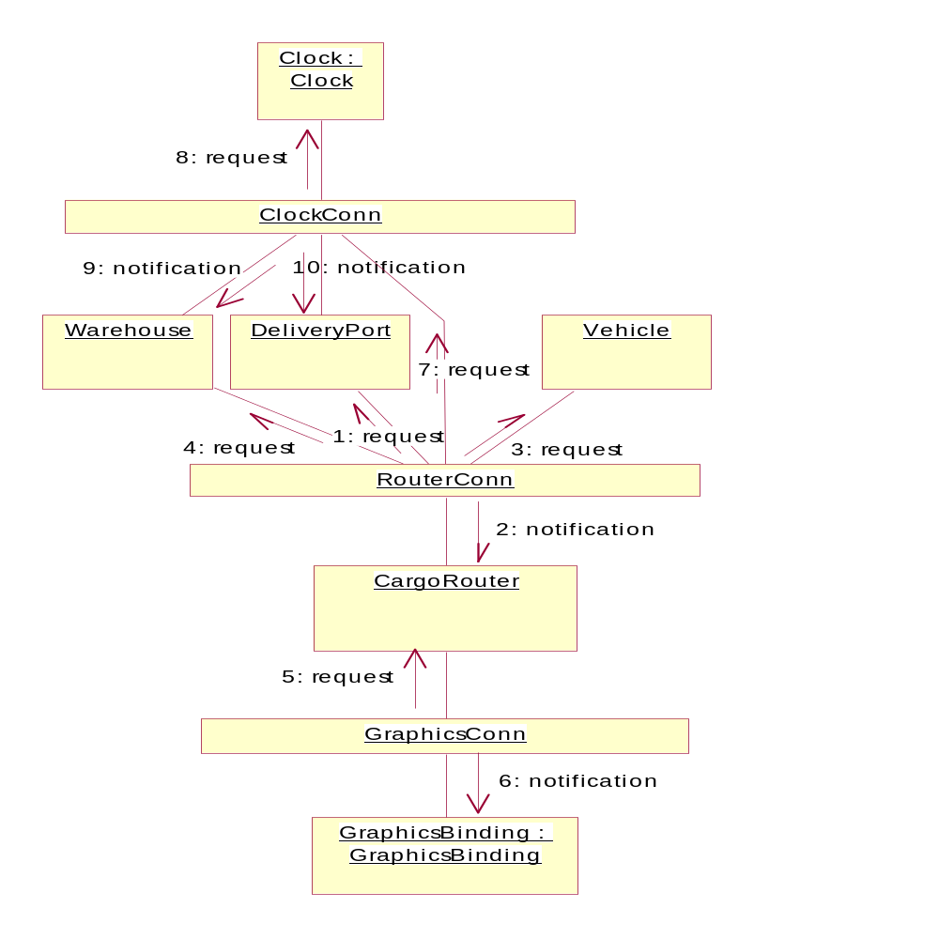
Architectural Abstraction
Events
Connectors
Components

Slide 9
What is not Design
Design is not programming.
Design is not modeling. Modeling is part of the architectural design.
Design is not part of requirements.
Where requirements finishes and where design starts ?.
Requirements = What the system is supposed to do.
Design = How the system is built.

Slide 10
What is Design (or Architecture?)
A high-level model of a software system
  Describes the structure, functionality and characteristics of the software system.
  Understandable to many stakeholders
  Allows evaluation of the system’s properties before it is built
  Provides well understood tools and techniques for constructing the thing from its blueprint
A software system’s blueprint
  Its components
  Their interactions
  Their interconnections
Which aspects of a software system are architecturally relevant?

Slide 11
What is Design (or Architecture?)
How should they be represented most effectively to enable stakeholders to understand, reason, and communicate about a system before it is built?
What tools and techniques are useful for implementing an architecture in a manner that preserves its properties?
We design the software but we must consider the hardware (and the environment).
Design must reflect requirements, and we must be able to relate each requirements with parts of the design.
How can we include non-functional requirements into the design?

Slide 12
Stages of design
Problem understanding
  Look at the problem from different angles to discover the
  design requirements
Identify one or more solutions
  Evaluate possible solutions and choose the most
  appropriate depending on the designer's experience and
  available resources
Describe solution abstractions
  Use graphical, formal or other descriptive notations to
  describe the components of the design
Repeat process for each identified abstraction
until the design is expressed in primitive terms

Slide 13
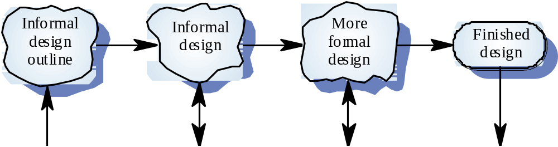
From informal to formal design

Slide 14
The design process
The system should be described at several
different levels of abstraction
Design takes place in overlapping stages. It is
artificial to separate it into distinct phases but
some separation is usually necessary

Slide 15
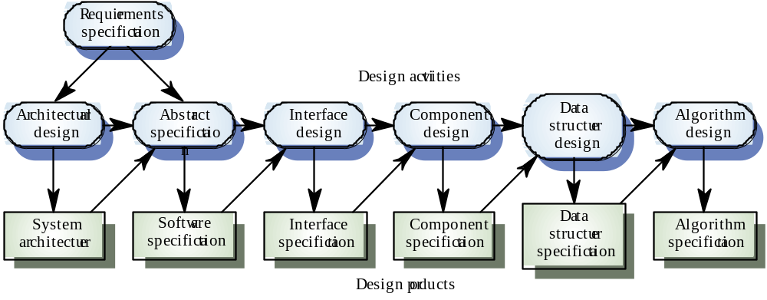
Phases in the design process

Slide 16
Design phases
Architectural design Identify sub-systems
Abstract specification Specify sub-systems
Interface design Describe sub-system interfaces
Component design Decompose sub-systems
into components
Data structure design Design data structures to hold problem data
Algorithm design Design algorithms for problem functions

Slide 17
From Requirements to Architecture
From problem definition to requirements specification
  Determine exactly what the customer and user want
  Specifies what the software product is to do
From requirements specification to architecture
  How do we plan to build (design) the system ?
  Decompose software into modules with interfaces
  Specify high-level behavior, interactions, and non-functional properties
  Consider key tradeoffs
    Schedule vs. Budget
    Cost vs. Robustness
    Fault Tolerance vs. Size
    Security vs. Speed
  Maintain a record of design decisions and traceability
  Specifies how the software product is to do its tasks (from design to programming).

Slide 18
Architectural design
An early stage of the system design process.
Represents the link between specification and design processes.
Where do we finish requirements and start design ?.
Often carried out in parallel with some specification activities.
It involves identifying major system components and their communications.

Slide 19
Advantages of explicit architecture
From Requirements to Design
Stakeholder communication
  Architecture may be used as a focus of discussion by system stakeholders.
System analysis
  Means that analysis of whether the system can meet its non-functional requirements is possible.
Large-scale reuse
  The architecture may be reusable across a range of systems.
From Design to Programming ,Testing & Mantenaince.

Slide 20
Architecture and system characteristics
How the system must be designed to achieve:
Performance
Security
Safety
Reliability
Availability
Maintainability
Quality

Slide 21
Architectural design process
System structuring
  The system is decomposed into several principal sub-systems and communications between these sub-systems are identified
Control modelling
  A model of the control relationships between the different parts of the system is established
Modular decomposition
  The identified sub-systems are decomposed into modules

Slide 22
Design quality
Design quality is an elusive concept. Quality depends on specific organisational priorities
A 'good' design may be the most efficient, the
cheapest, the most maintainable, the most
reliable, etc.
The attributes discussed here are concerned
with the maintainability of the design
Quality characteristics are equally applicable to
function-oriented and object-oriented designs

Slide 23
Design principles
Abstraction
Modularity, coupling and cohesion
Information hiding
Limit complexity
Hierarchical structure
Understandability
Adaptability

Slide 24
Abstraction
procedural abstraction: natural consequence of stepwise refinement: name of procedure denotes sequence of actions
abstraction
subproblems
time

Slide 25
Abstraction
data abstraction: aimed at finding a hierarchy in the data
application-oriented
data structures
simpler data
structure
general
data structures

Slide 26
Modularity
structural criteria which tell us something about individual modules and their interconnections
cohesion and coupling
cohesion: the glue that keeps a module together
coupling: the strength of the connection between modules

Slide 27
Cohesion
A measure of how well a component 'fits
together'
A component should implement a single logical
entity or function
Cohesion is a desirable design component
attribute as when a change has to be made, it
is localised in a single cohesive component
Various levels of cohesion have been identified

Slide 28
Cohesion levels
Coincidental cohesion (weak)
  Parts of a component are simply bundled together
Logical association (weak)
  Components which perform similar functions are grouped
Temporal cohesion (weak)
  Components which are activated at the same time are grouped
Procedural cohesion (weak)
  The elements in a component make up a single control sequence

Slide 29
Cohesion levels
Communicational cohesion (medium)
  All the elements of a component operate on the same input or produce the same output
Sequential cohesion (medium)
  The output for one part of a component is the input to another part
Functional cohesion (strong)
  Each part of a component is necessary for the execution of a single function
Object cohesion (strong)
  Each operation provides functionality which allows object attributes to be modified or inspected

Slide 30
Cohesion as a design attribute
Not well-defined. Often difficult to classify
cohesion
Inheriting attributes from super-classes
weakens cohesion
To understand a component, the super-classes
as well as the component class must be
examined
Object class browsers assist with this process

Slide 31
Coupling
A measure of the strength of the inter-connections between system components
Loose coupling means component changes are unlikely to affect other components
Shared variables or control information
exchange lead to tight coupling
Loose coupling can be achieved by state
decentralisation (as in objects) and component
communication via parameters or message
passing
28

Slide 32
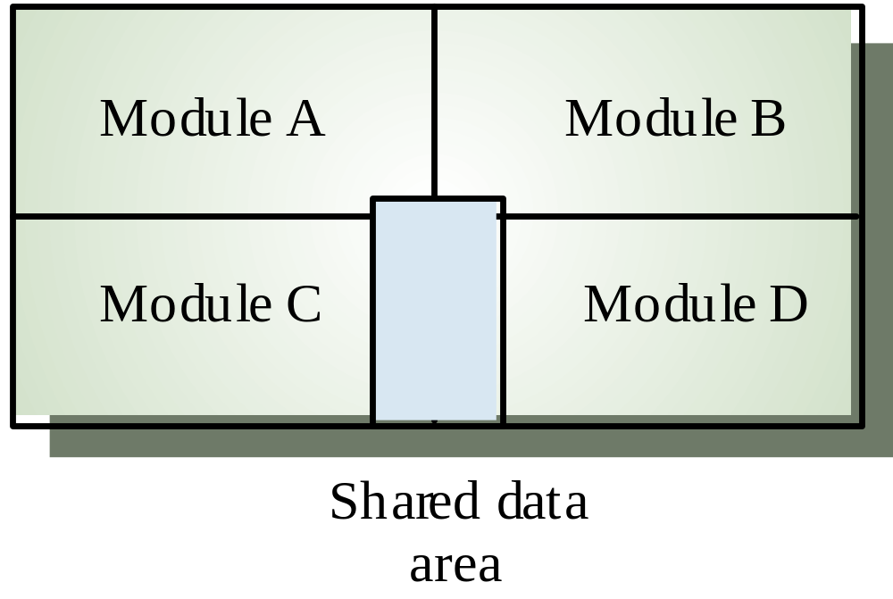
Tight coupling

Slide 33
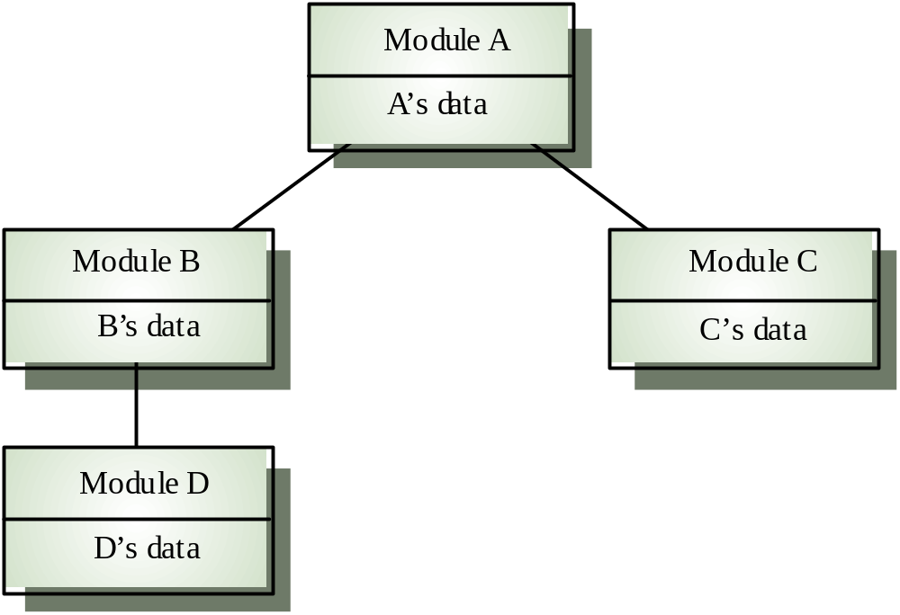
Loose coupling

Slide 34
Coupling and inheritance
Object-oriented systems are loosely
coupled because there is no shared state and
objects communicate using message passing
However, an object class is coupled to its
super-classes. Changes made to the attributes
or operations in a super-class propagate to all
sub-classes. Such changes must be carefully
controlled

Slide 35
Information hiding
each module has a secret
design involves a series of decision: for each such decision, wonder who needs to know and who can be kept in the dark
information hiding is strongly related to
  abstraction: if you hide something, the user may abstract from that fact
  coupling: the secret decreases coupling between a module and its environment
  cohesion: the secret is what binds the parts of the module together

Slide 36
Complexity
measure certain aspects of the software (lines of code, # of if-statements, depth of nesting, …)
use these numbers as a criterion to assess a design, or to guide the design
interpretation: higher value ⇒ higher complexity ⇒ more effort required (= worse design)
two kinds:
  intra-modular: inside one module
  inter-modular: between modules

Slide 37
Top-down design
In principle, top-down design involves starting
at the uppermost components in the hierarchy
and working down the hierarchy level by level
In practice, large systems design is never
truly top-down. Some branches are designed before others. Designers reuse experience (and
sometimes components) during the design
process

Slide 38
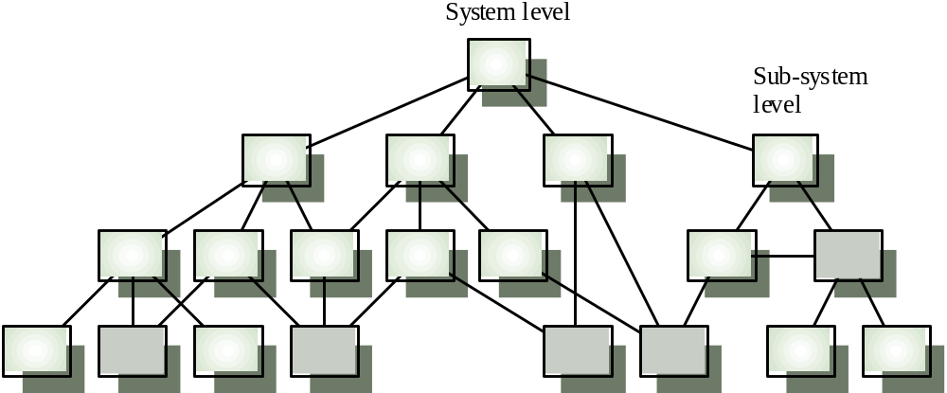
Hierarchical design structure

Slide 39
Understandability
Related to several component characteristics
  Cohesion. Can the component be understood on its own?
  Naming. Are meaningful names used?
  Documentation. Is the design well-documented?
  Complexity. Are complex algorithms used?
Informally, high complexity means many
relationships between different parts of the
design. hence it is hard to understand
Most design quality metrics are oriented
towards complexity measurement. They are
of limited use
32

Slide 40
Adaptability
A design is adaptable if:
  Its components are loosely coupled
  It is well-documented and the documentation is up to date
  There is an obvious correspondence between design levels (design visibility)
  Each component is a self-contained entity (tightly cohesive)
To adapt a design, it must be possible to trace the links between design components so that change consequences can be analysed
33

Slide 41
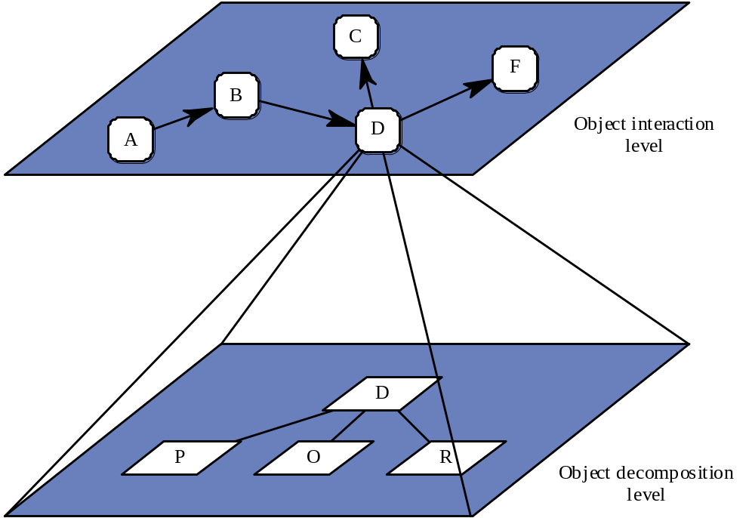
Design traceability

Slide 42
Key points
Design is a creative process
Design activities include architectural design,
system specification, component design, data
structure design and algorithm design
36

